Slide 1
Reconstruction from projections
Acknowledgement:
Blue-background slides compiles from a presentation of Terry Peters, Robarts Research Institute, London Canada

Slide 2
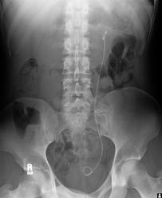
Standard x-ray

Slide 3
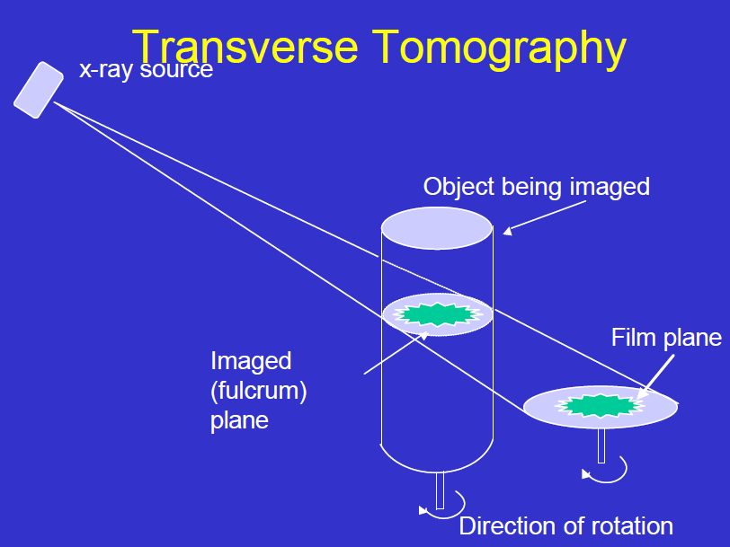

Slide 4
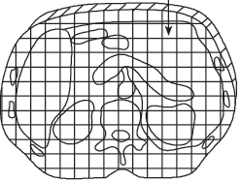
Principle of backprojection
The transmission of a beam through a single voxel
Each pixel in the image represents a voxel of tissue in the patient
A raysum is the sum of absorption along the path of a single ray through the patient

Slide 5
Principle of backprojection
3
15
4
1 | 1 | 2
2 | 10 | 2
3 | 2 | 1
4
14
6
3
12
4
6 | 13 | 5

Slide 6
Principle of backprojection
3
X1+X2+X3=4
. . .
X4+X2=3
. . .
X1+X4+X7=6
. . .
X1+X5+X9=12
. . .
15
4
X1 | X2 | X3
X4 | X5 | X6
X7 | X8 | X9
4
14
6
3
12
4
Solve for X1 ... X9
6 | 13 | 5

Slide 7
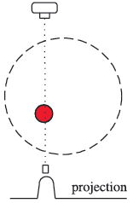
Principle of backprojection

Slide 8
Principle of backprojection
Matlab example

Slide 9
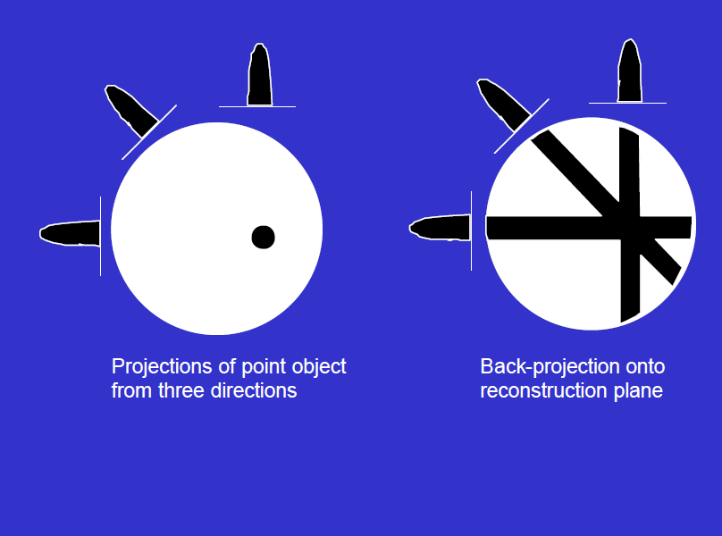

Slide 10
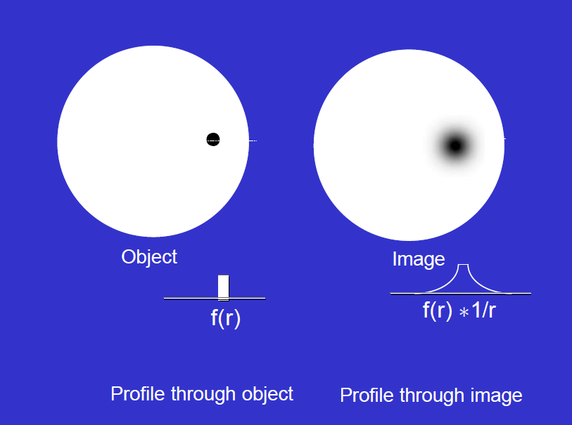

Slide 11
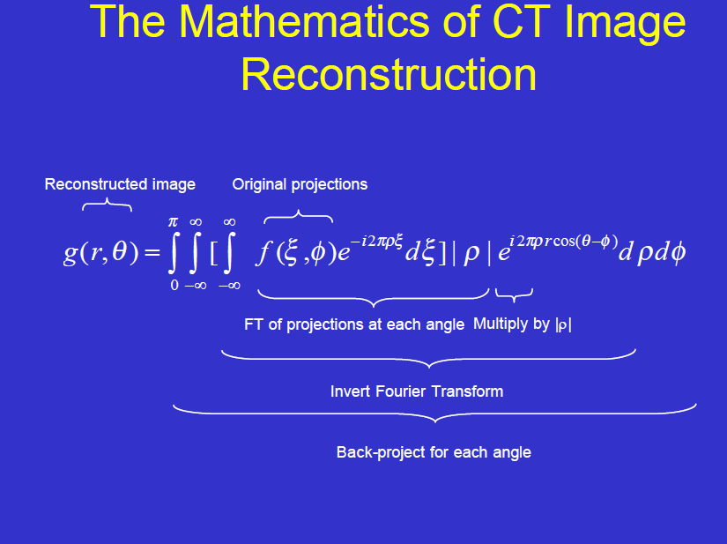

Slide 12
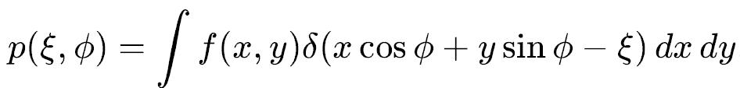
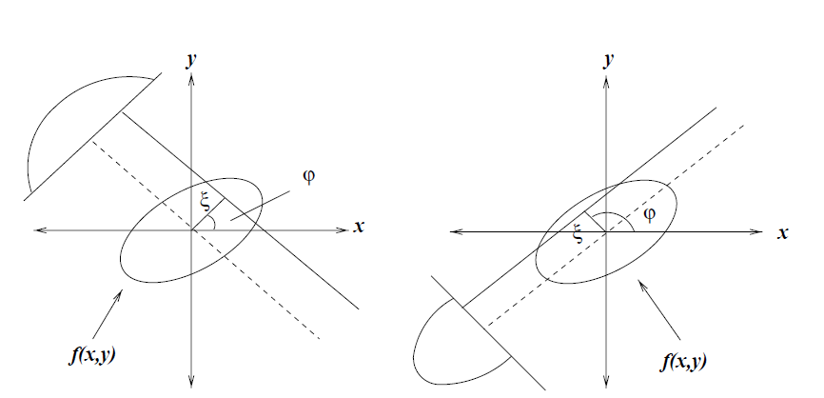
Radon transform
p
p

Slide 13
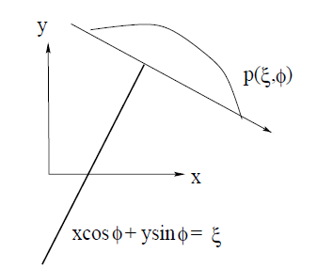
Radon transform

Slide 14
Blur

Slide 15
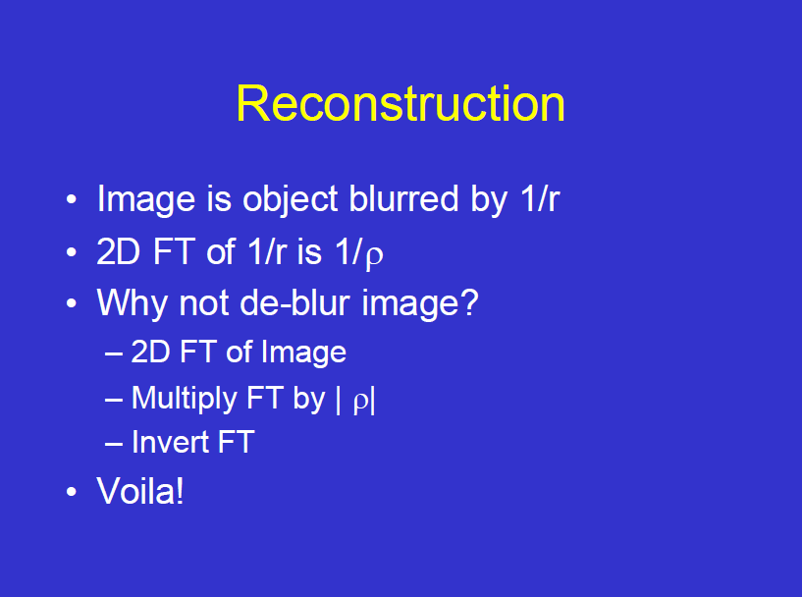

Slide 16
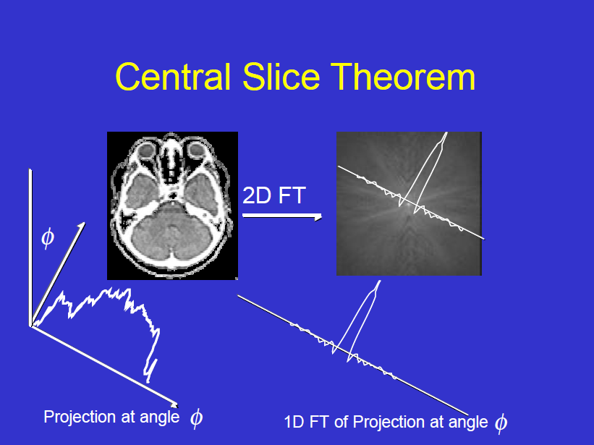

Slide 17
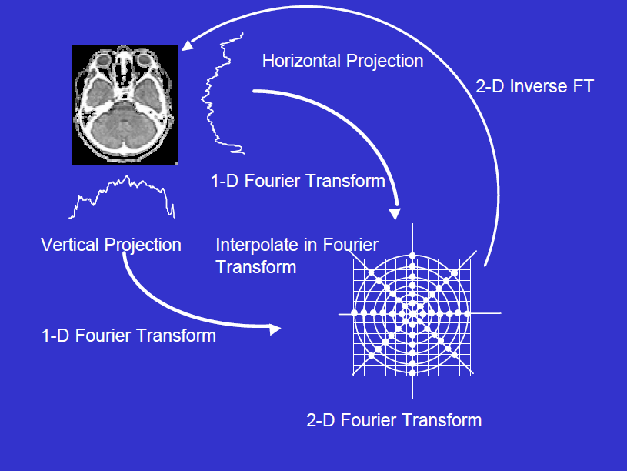

Slide 18
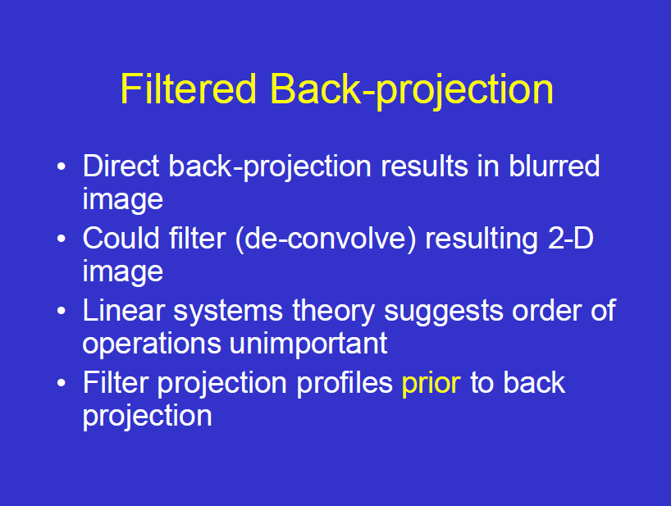

Slide 19
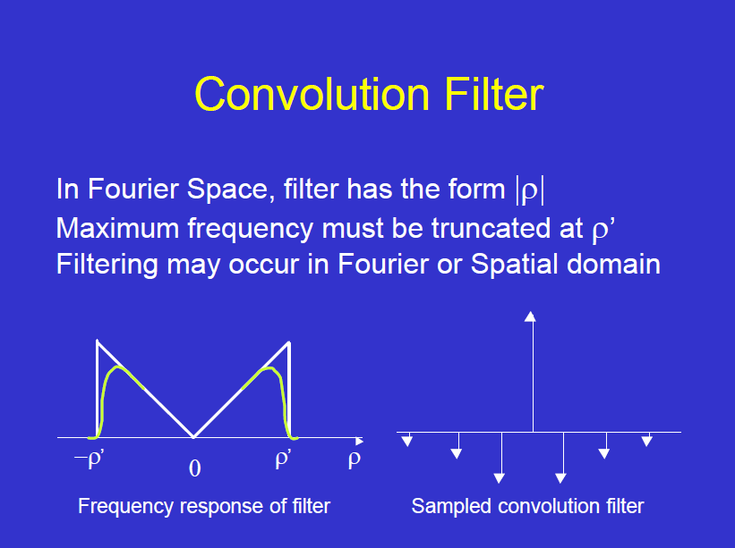

Slide 20
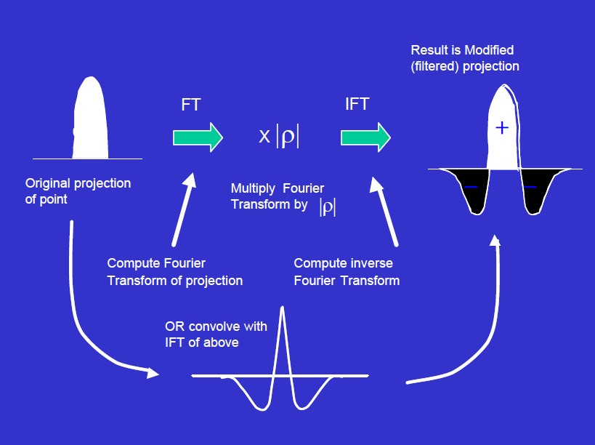

Slide 21
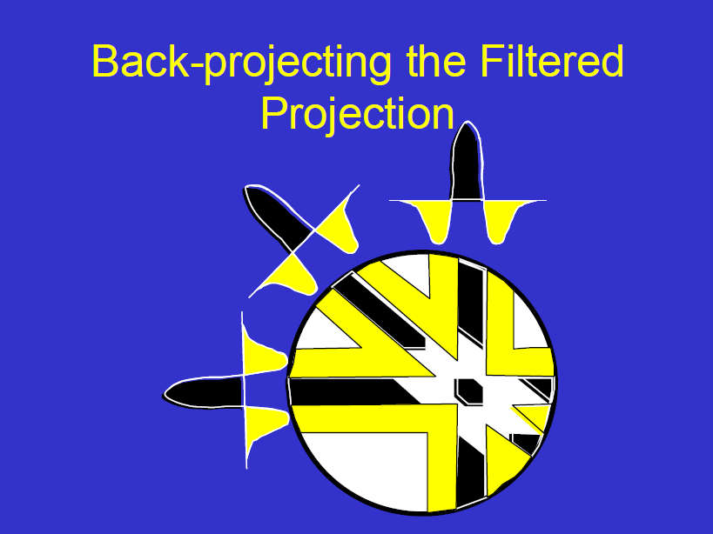

Slide 22
Radon transform
Matlab example

